Slide 1

Docker Overview
January 2020

Slide 2
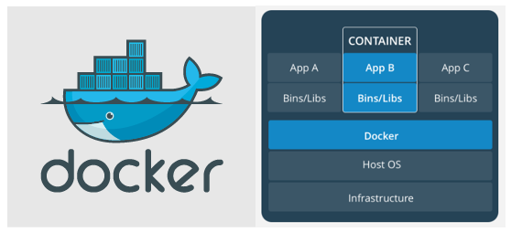
What is Docker?
Docker is a containerization platform that packages your application and all its dependencies together in the form of a docker container to ensure that your application works seamlessly in any environment.

Slide 3
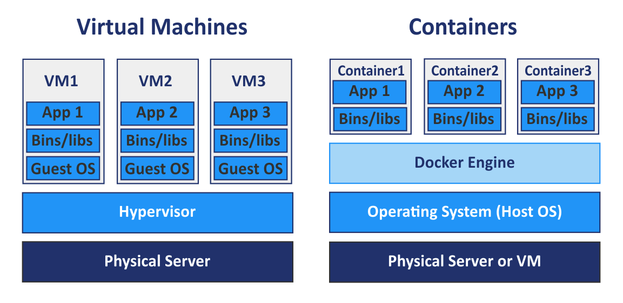
Docker Container vs Virtual Machine
VM resource allocation is static, can be configured only at the time we build the VM.
Docker allocation is dynamic, and the max/min allocation can be configured during the container launch
VM boot is slow, because we need to launch the guest OS as well
Container launch in seconds, just like application

Slide 4
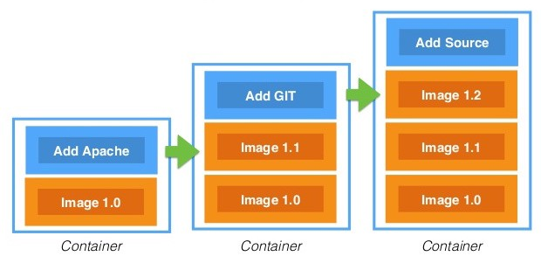
Docker Image and Container Layer
Ubuntu:18.04

Slide 5
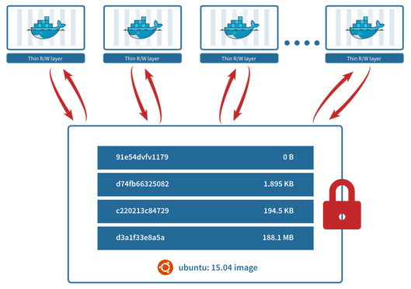
Reuse Image for Multiple Services
API endpoint
Database 2
Cache
Database 1

Slide 6
Hands-On
Heads to
https://github.com/PratamaAgung/docker-sharing-session

